Slide 1

Development of an Assessment & Advisory E-learning System for Physics using LabVIEW
Yan Bingtao 137160X
pang jun qing 111111a
Supervisor: Mr. Cheong chee keng

Slide 2
Content:
Background
New Features
Troubleshooting
What did I do (Database)
Gantt chart
Future work
Program Flow
Q & A

Slide 3
Objectives:
Create Administration Panel;
Save current process and continue next time;
Save all significant data;
Improve Efficiency;
Improve GUI layout;
Server Database;

Slide 4

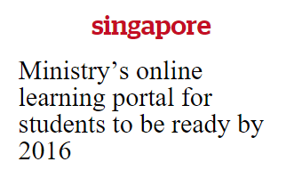
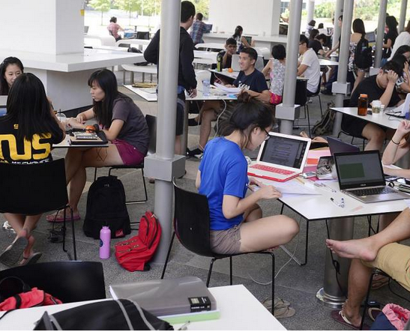
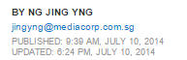

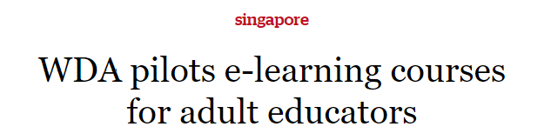
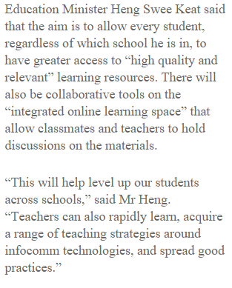
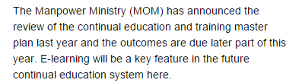
Background
Collaborative tools
Accessible for Everyone
Access Everywhere
1
2
3

Slide 5
Why us?

Slide 6
Structure Questions
Randomized value
Mark intelligently
Give Explanations
Attempt questions from different topics

Slide 7
Admin Login Page
No. of Questions Running
No. of Attempts
Auto-creating Tables
Improve Efficiency
Fully Record

Slide 8
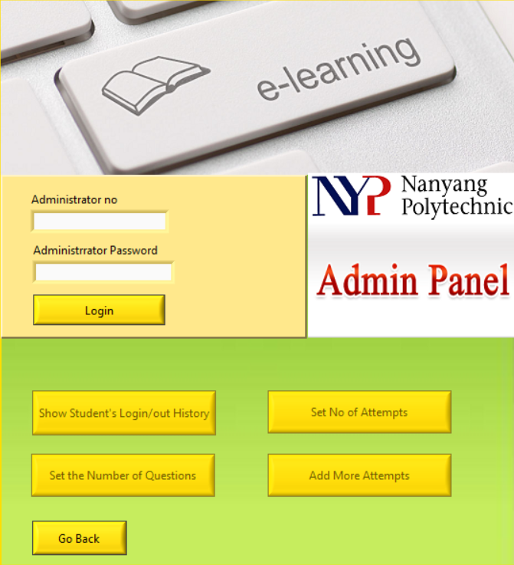
Admin Login Panel
(LabVIEW)
Login/out History
Set No. of Attempts
Admin Login Page
Set No. of Questions
Add More Attempts

Slide 9
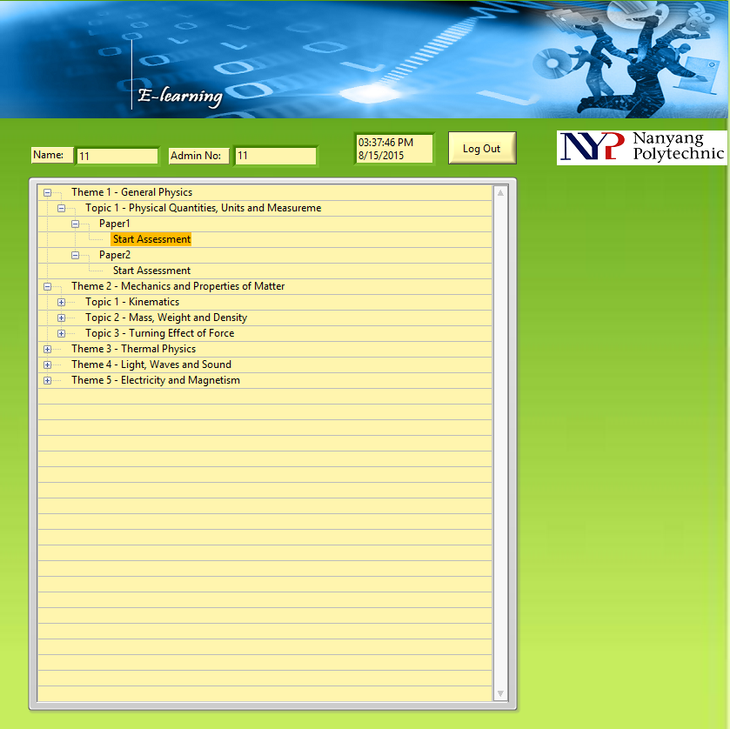
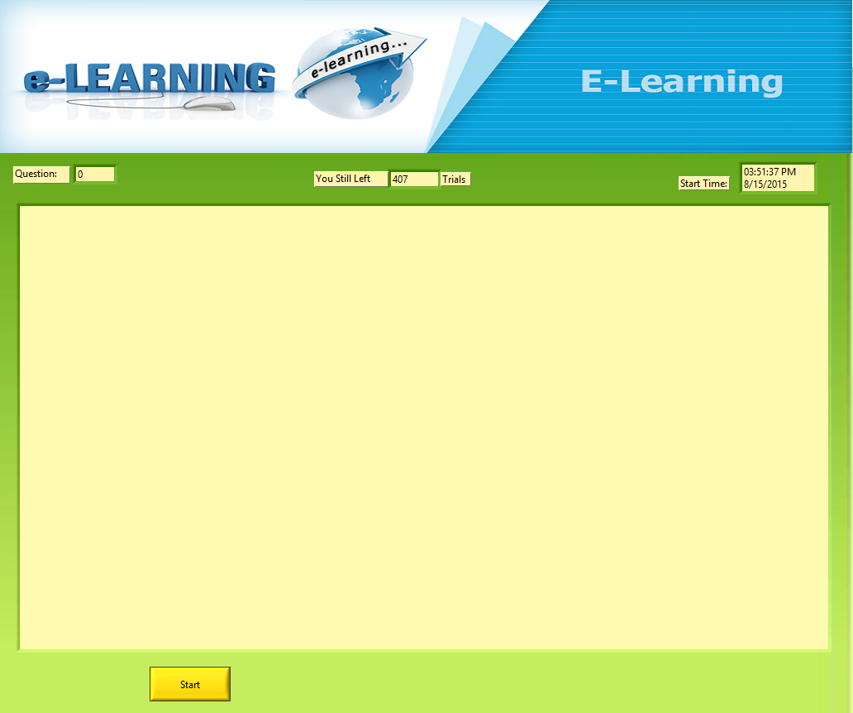
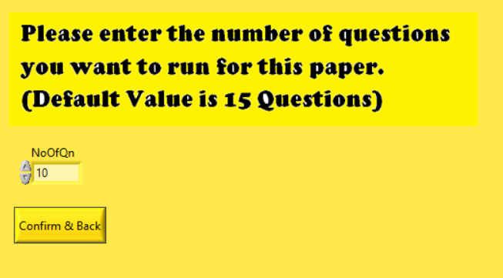
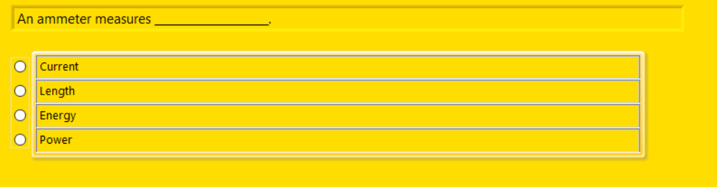

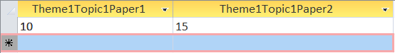


No. of Questions Running
(LabVIEW)
Set No. of Questions
Tree Control
Check & Set “NoOfQnRunning”
Start Attempt

Slide 10

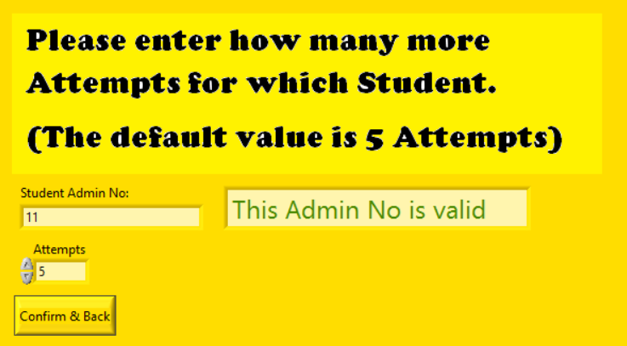

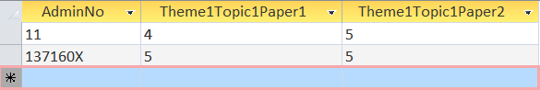
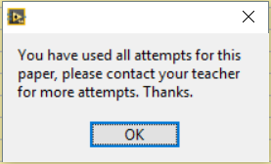
No. of Attempts
(LabVIEW)
Set No. of Attempts
Add More Attempts
Tree Control
Check Database
Attempt>0
Attempt=0
Start Attempt
Reject

Slide 11
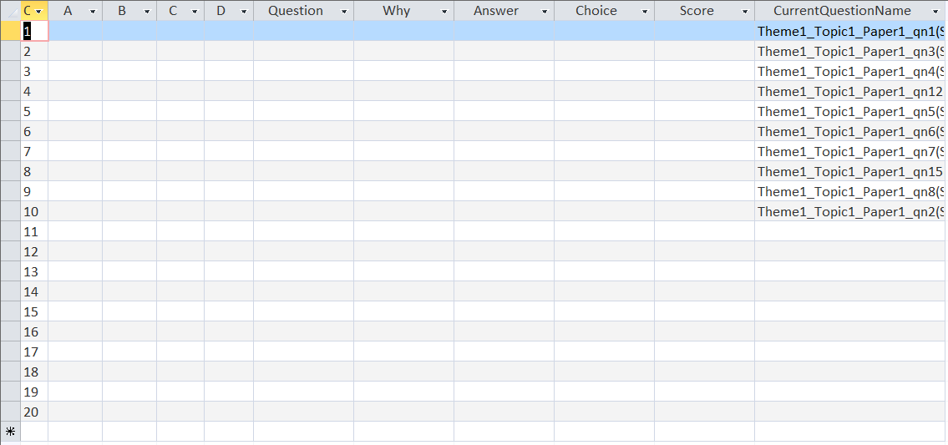
Auto-creating Tables Fully record data
(LabVIEW)
Theme[#]Topic[#]Paper[#]_[Admin No]_Attempt[#]
Tree Control
Auto Create Table
Start Attempt
Notes:
And fully record all the data without overwriting

Slide 12
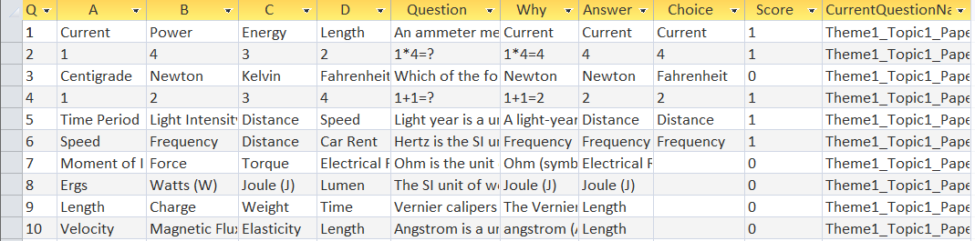
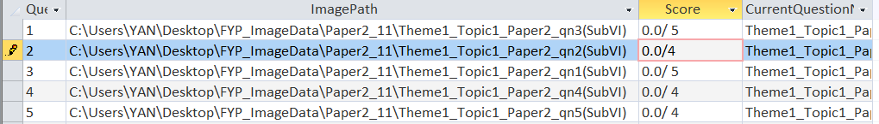
Improve Efficiency
(LabVIEW)
Paper1
Start Attempt
Paper1
Paper2
Paper2
Save data in Databse
Screenshots
Review Qn

Slide 13
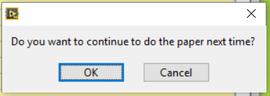
Save process & Continue next time
(LabVIEW)

Slide 14
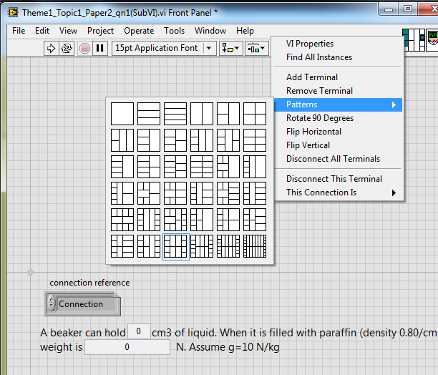
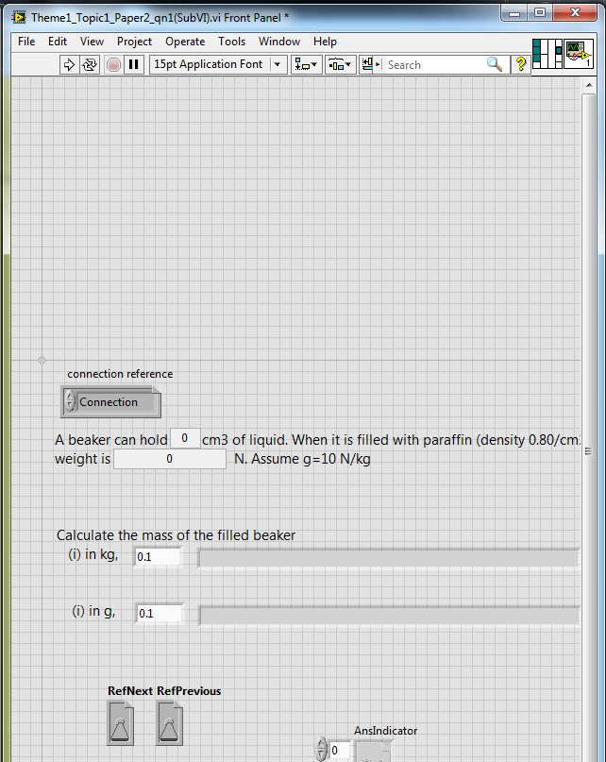
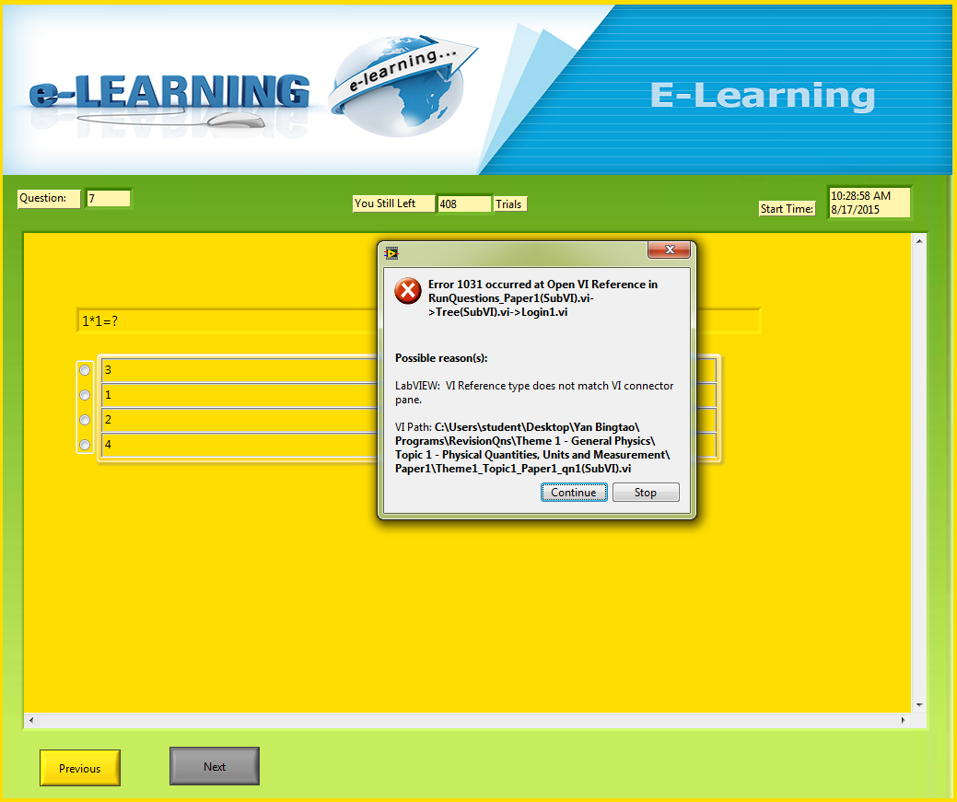
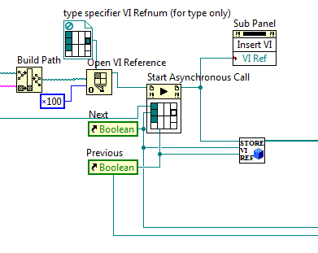
Troubleshooting 1:
Mismatching VI Reference Type

Slide 15
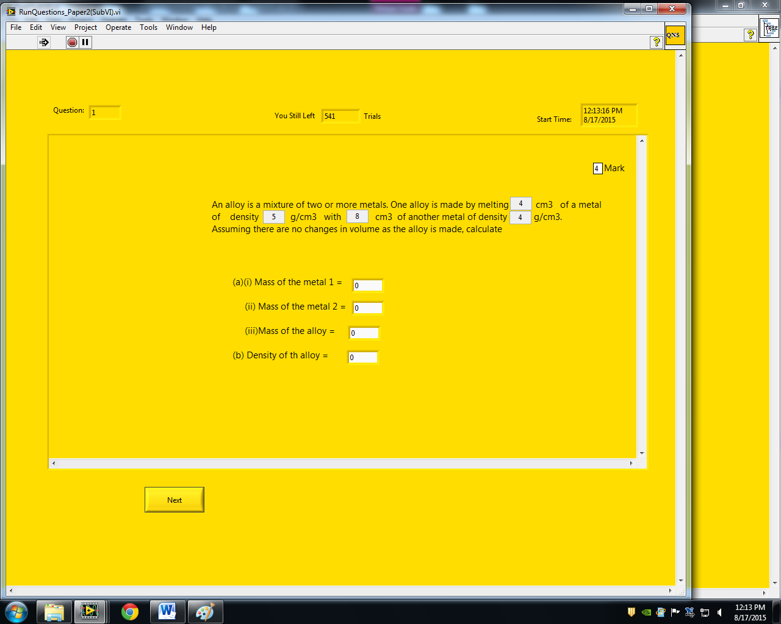
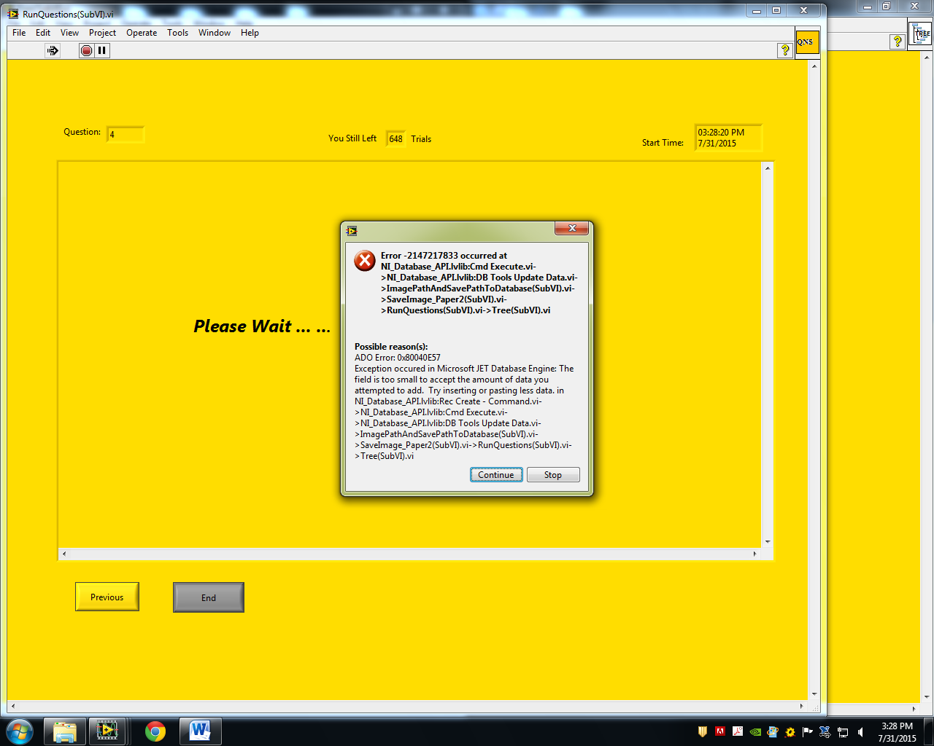
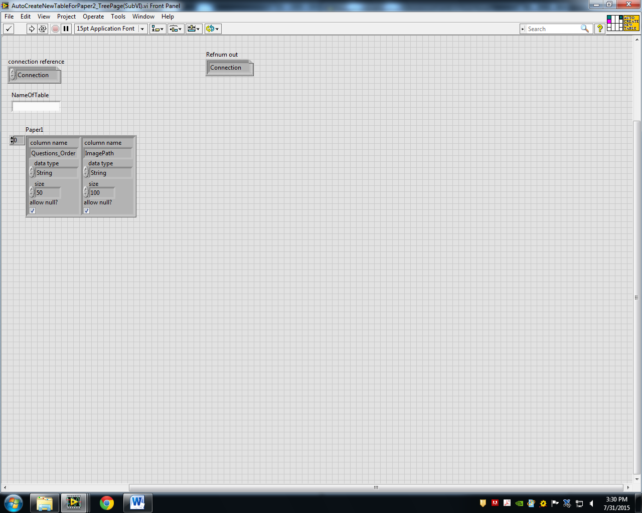
Troubleshooting 2:
Column Size too small
Paper2

Slide 16
JQ

Slide 17
What did I do:
Learn how to create database
Create database
Create server database
Create physics questions for paper 1
Share database with multiple users

Slide 18
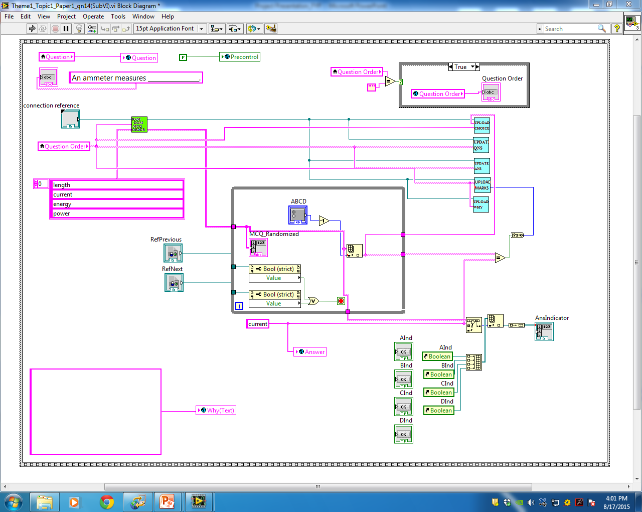
physics questions for paper1:
Create multiple choice questions(MCQ) for paper 1

Slide 19
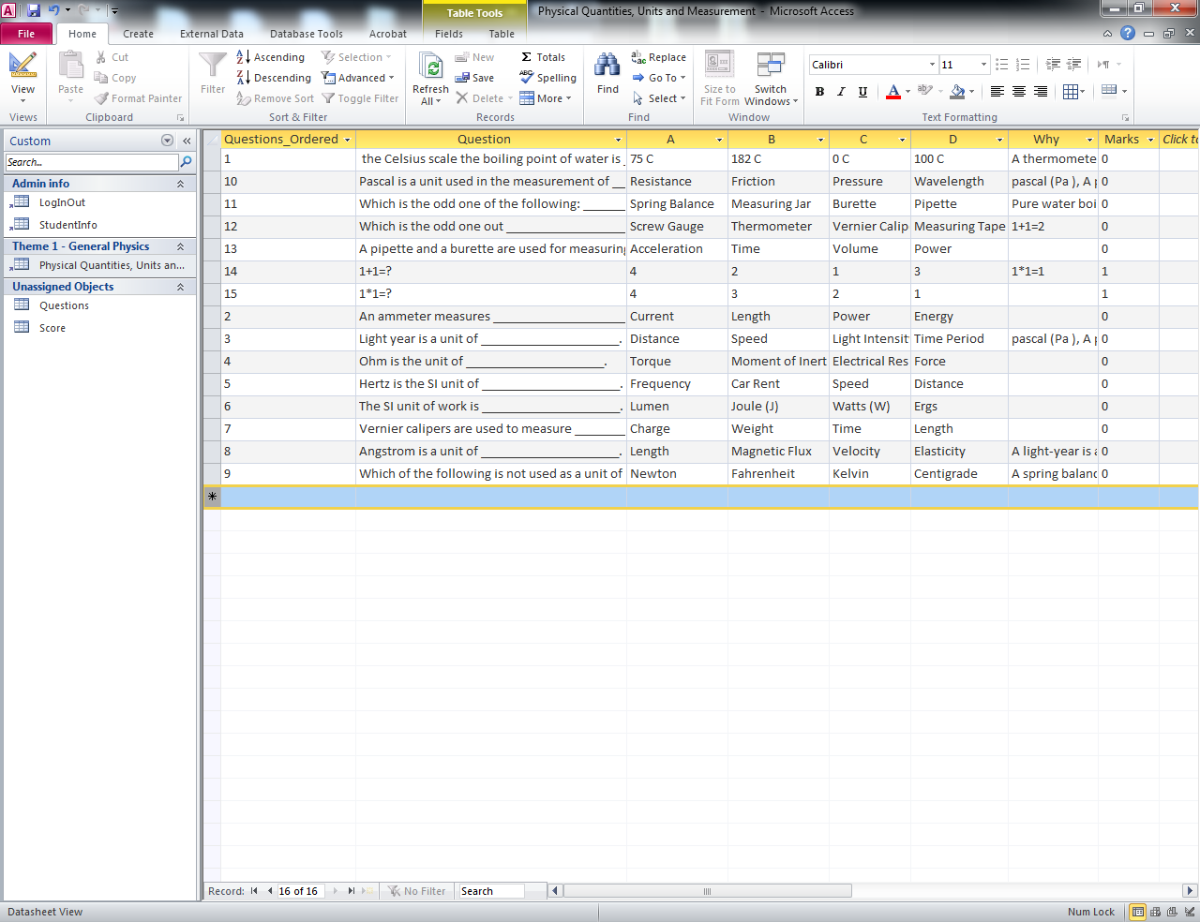
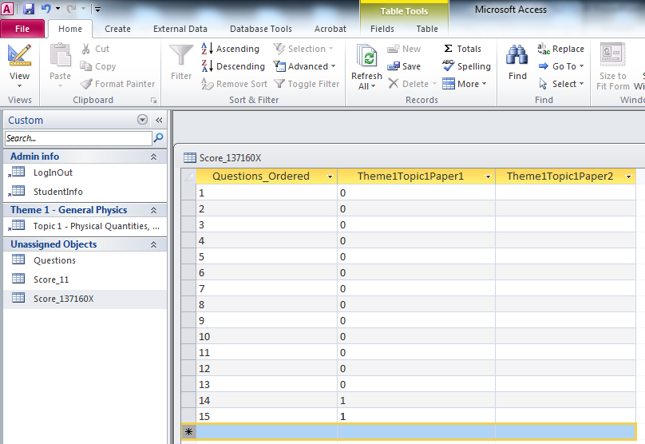
Database
Create a database consist tables of:
Login/logout history
Student information (Student name, username and password)

Slide 20
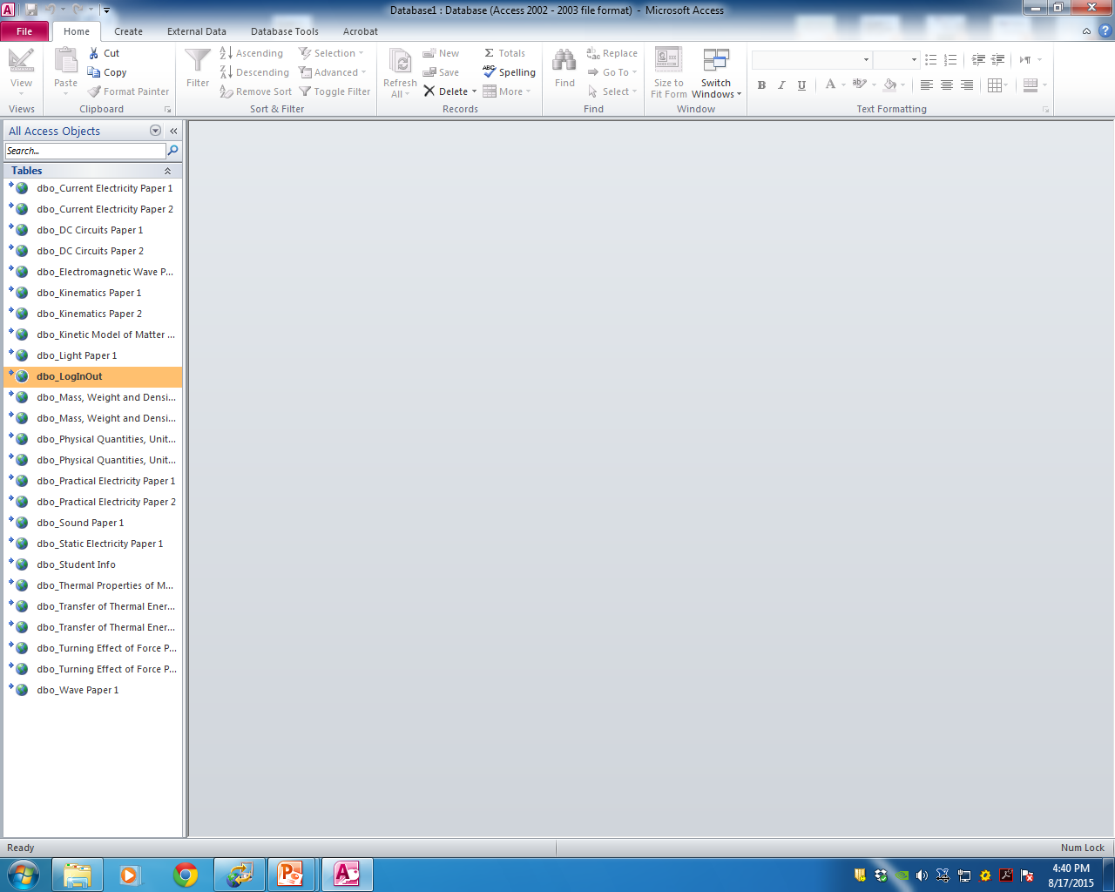
Share Database with multiple users
Install SQL server
Create a database server
Share the database by exporting the records to the server.

Slide 21
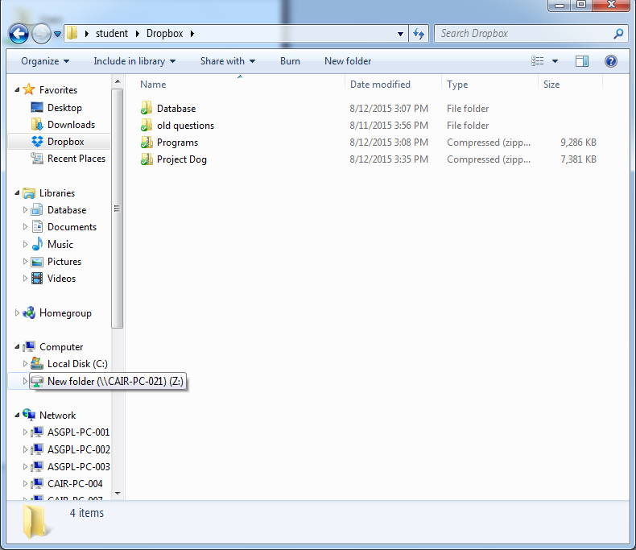
Share Database with multiple users
Install Dropbox
Create a Dropbox folder
Share the database using the folder.

Slide 22
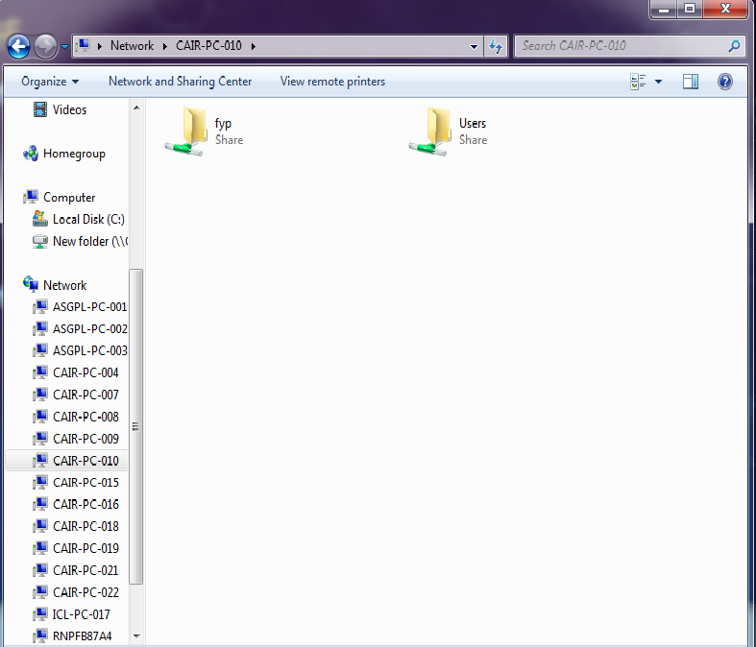
Share Database with multiple users
Create a new folder
Share the folder over a network

Slide 23
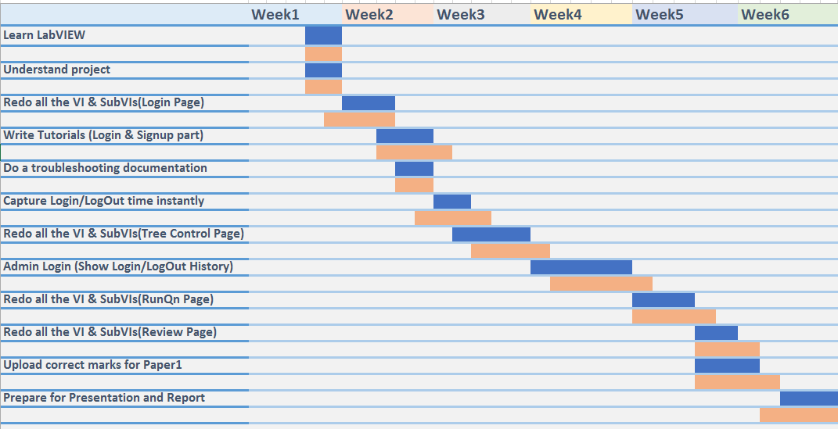
Gantt chart_Yanbingtao (Wk1-wk6)

Slide 24
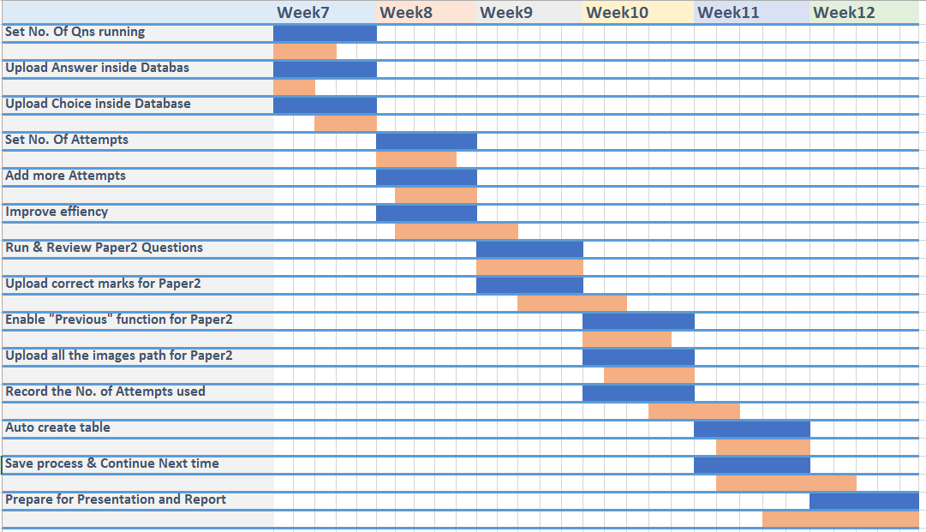
Gantt chart_Yanbingtao (Wk7-wk12)

Slide 25
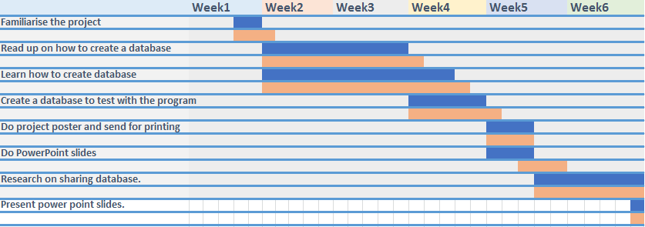
Gantt chart_Pangjunqing (Wk1-wk6)

Slide 26
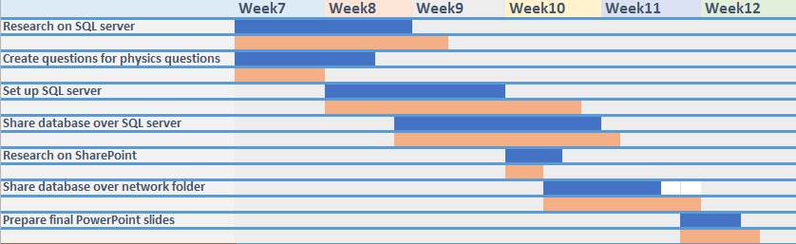
Gantt chart_Pangjunqing (Wk7-wk12)

Slide 27
future work:
Build a Question Base;
Show result changes graphically;
Create timers for each paper;
Create Exam-Simulation-Mode;

Slide 28
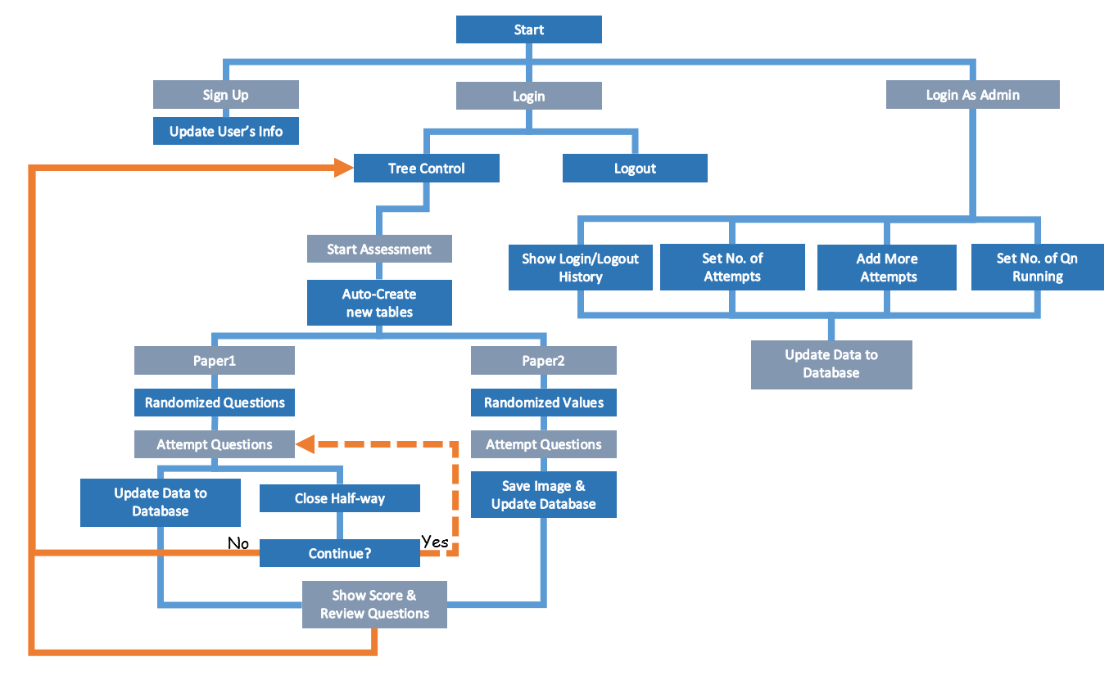
Program flow:

Slide 29

Main page (Login page):

Slide 30
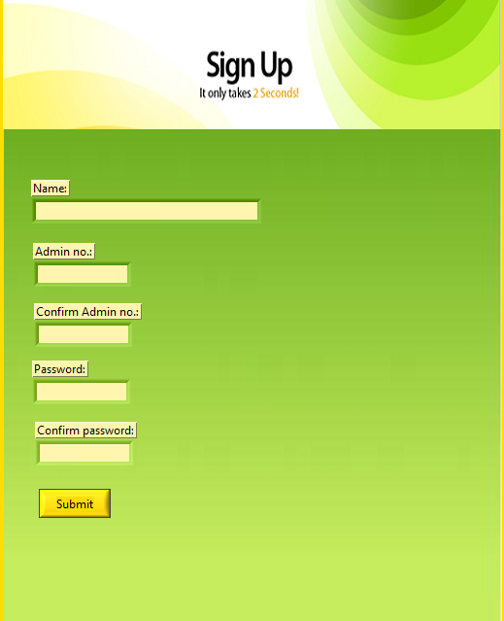
Signup page:

Slide 31
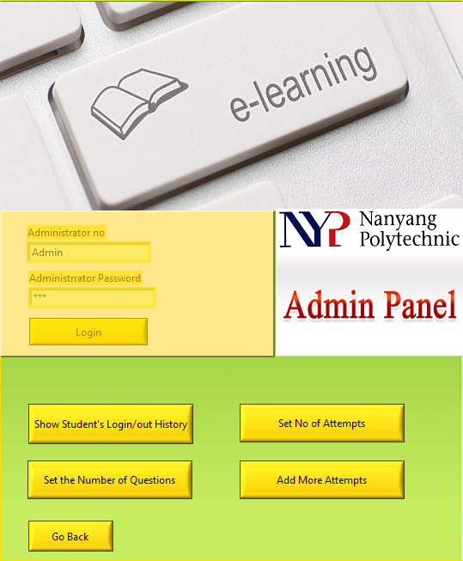
Admin Panel:

Slide 32
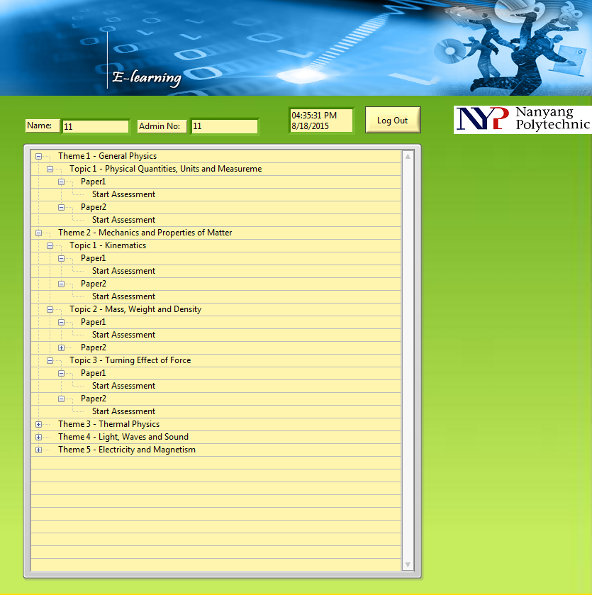
Tree control:

Slide 33
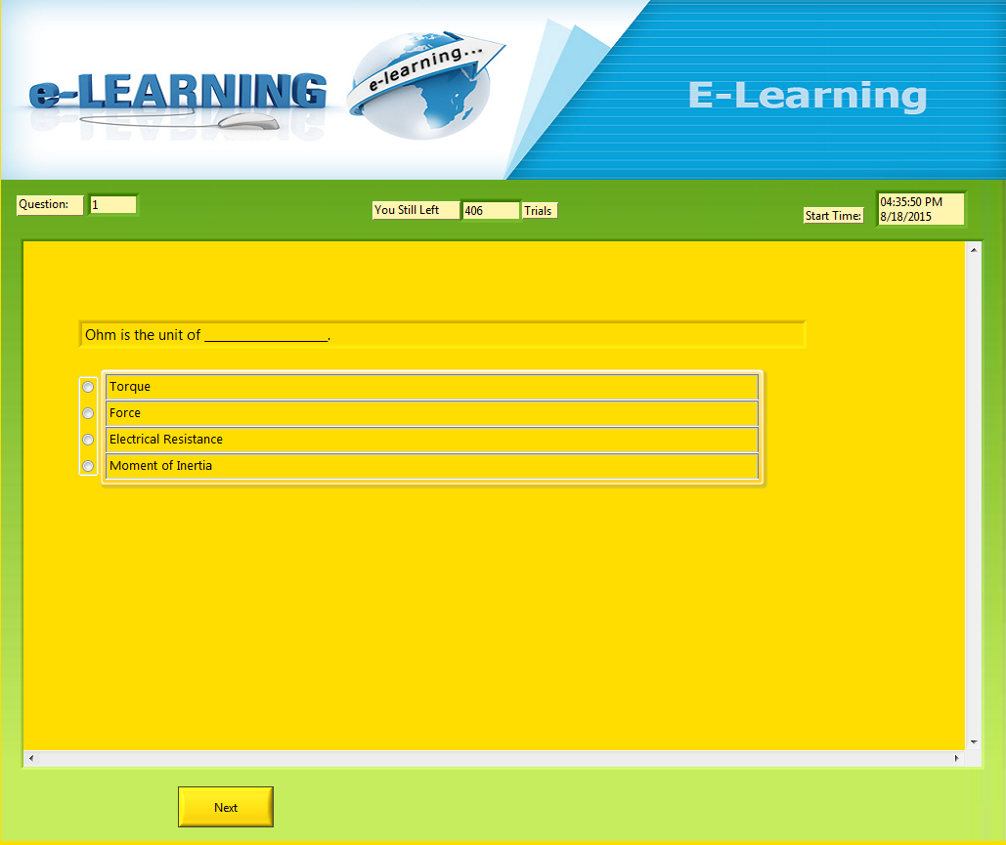
Run Question page (paper1):

Slide 34
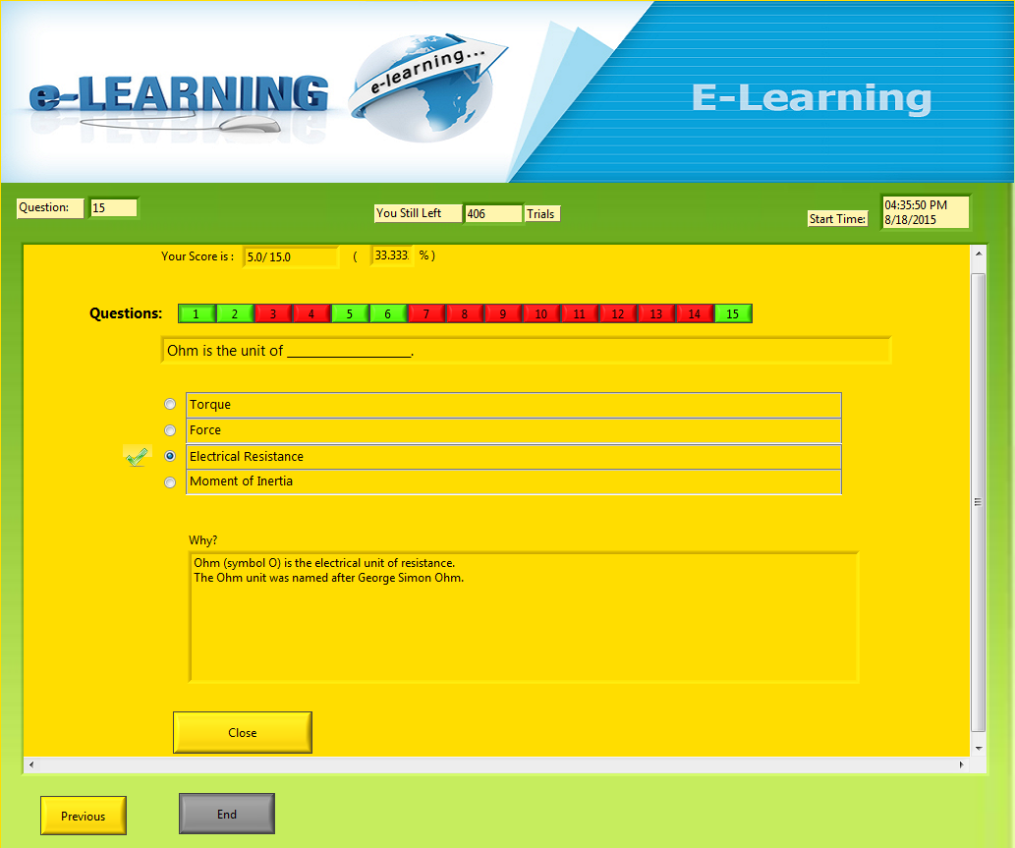
Review page (paper1):

Slide 35
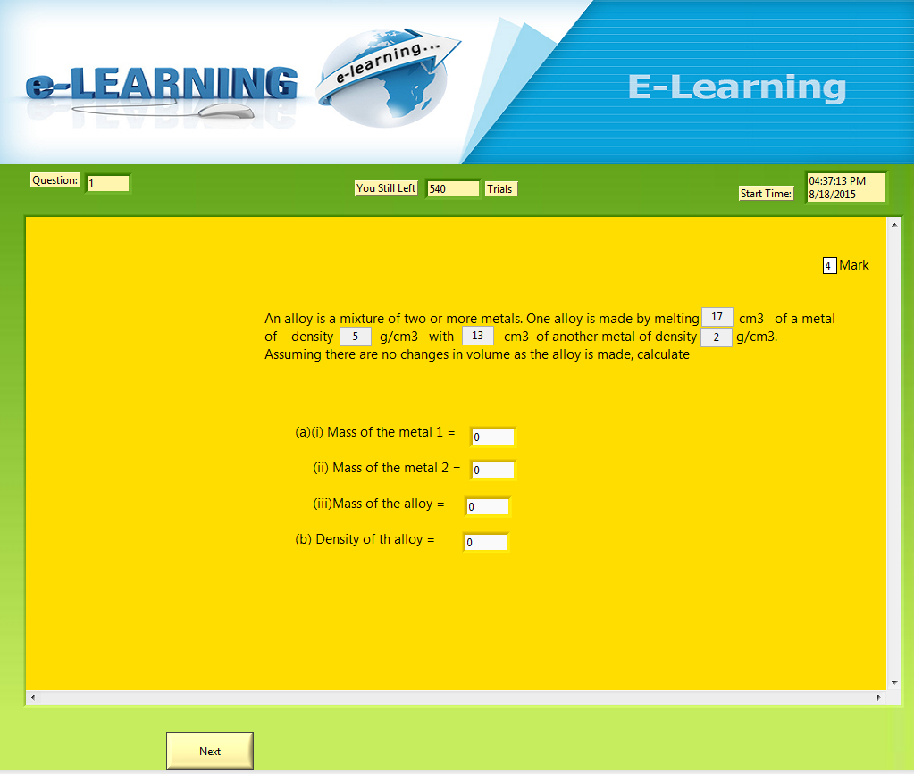
Run Question page (paper2):

Slide 36
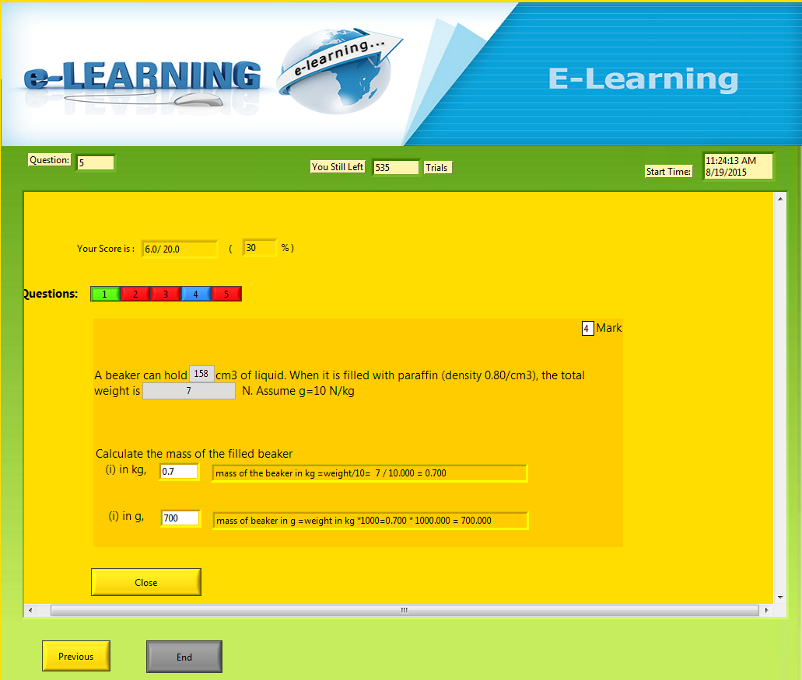
Review page (paper2):

Slide 37
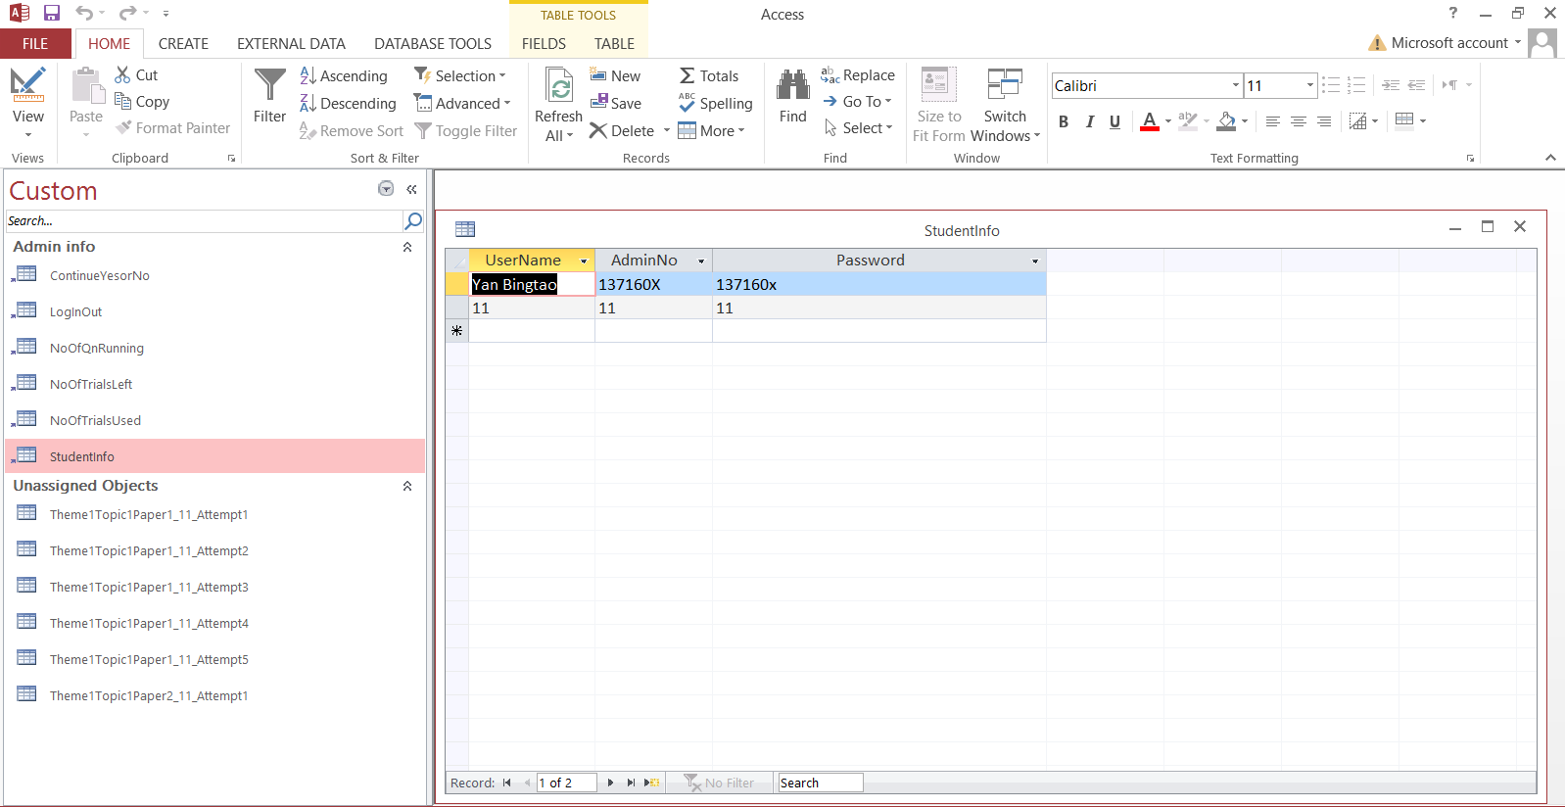
Database:

Slide 38
Q & A

Slide 39
Thank you !

